Slide 1
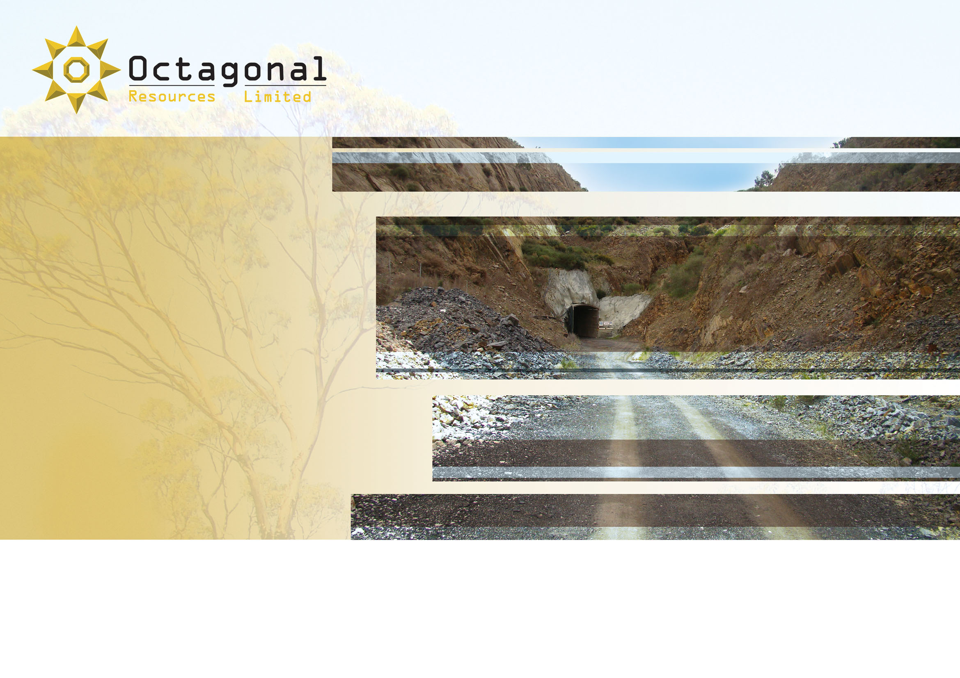
ASX Code: ORS
ABN: 38 147 300 418
Mines & Wines Conference
Orange, NSW
September 2013
“Mining Nuggetty Gold
in Central Victoria”
Photo: Portal of Union Hill Decline (Maldon, VIC)
www.octagonalresources.com.au

Slide 2

Disclaimer
Octagonal Resources Limited has prepared this presentation based on information available to it. No representation or warranty, express or implied, is made as to the fairness, accuracy, completeness or correctness of the information, opinions and conclusions contained in this presentation.
All dollar terms expressed in this presentation are in Australian dollars unless otherwise stated.
To the maximum extent permitted by law, none of Octagonal Resources Limited, its directors, employees or agents, advisers, nor any other person accepts any liability, including, without limitation, any liability arising from fault or negligence on the part of any of them or any other person, for any loss arising from the use of this presentation or its contents or otherwise arising in connection with it.
This presentation is not an offer, invitation, solicitation or other recommendation with respect to the subscription for, purchase or sale of any security, and neither this presentation nor anything in it shall form the basis of any contract or commitment whatsoever. This presentation may contain forward looking statements that are subject to risk factors associated with gold exploration, mining and production businesses. It is believed that the expectations reflected in these statements are reasonable but they may be affected by a variety of variables and changes in underlying assumptions which could cause actual results or trends to differ materially, including but not limited to price fluctuations, actual demand, currency fluctuations, drilling and production results, reserve estimations, loss of market, industry competition, environmental risks, physical risks, legislative, fiscal and regulatory changes, economic and financial market conditions in various countries and regions, political risks, project delay or advancement, approvals and cost estimates.
The information in this presentation that relates to mineral resources and exploration results are based on information compiled by Mr Anthony Gray who is a Member of the Australian Institute of Geoscientists. Any statement herein, direct or implied, as to a potential gold deposit is conceptual in nature and a reference to the targeted gold potential and not to any JORC compliant Mineral Resource. Mr Gray is a full time employee of Octagonal Resources Limited, and has sufficient experience which is relevant to the style of mineralisation under consideration to qualify as a Competent Person as defined in the 2004 edition of the JORC Code. Mr Gray has given his consent to the inclusion in this presentation of the matters based on the information in the form and context in which it appears.
The information in this presentation that relates to exploration and production targets refers to targets that are conceptual in nature, where there has been insufficient exploration to define a Mineral Resource and it is uncertain if further exploration will result in the determination of a Mineral Resource.

Slide 3
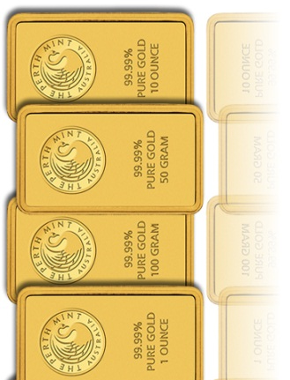
Contents
  Who is Octagonal Resources Limited ?
  Regional geology of the Bendigo Zone
  What is nuggetty gold ?
  Commercial challenges for mining nuggetty gold
  Strategy for mining in a nuggetty gold environment
  Local geology of Maldon Goldfield
  Discovery of Alliance South Deposit
    Exploration history
    Lessons learned
  Mining at the Alliance South Deposit
  Conclusions

Slide 4
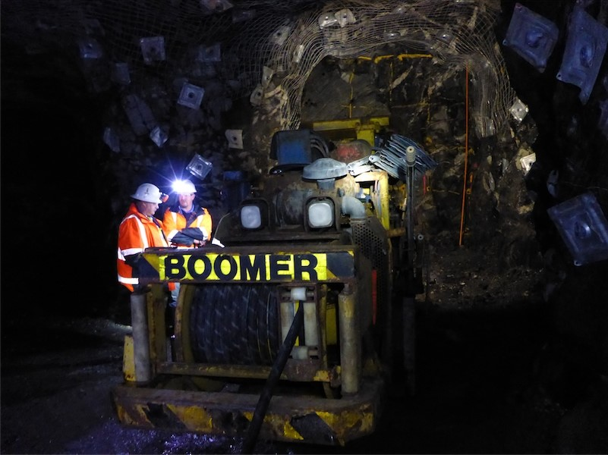
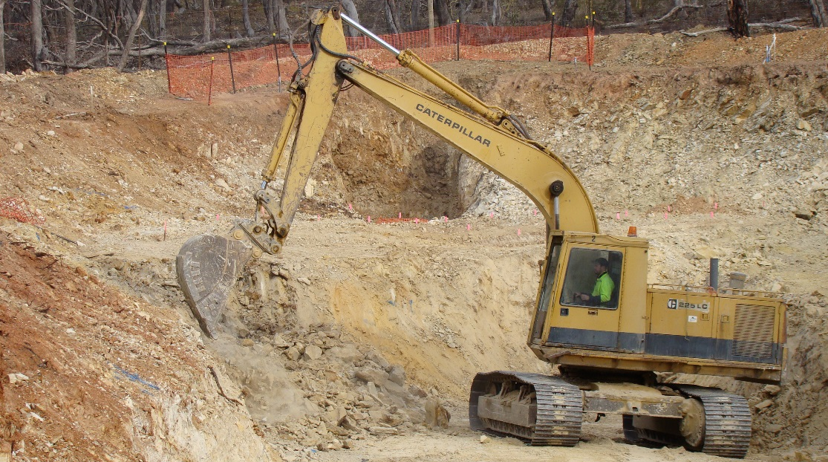
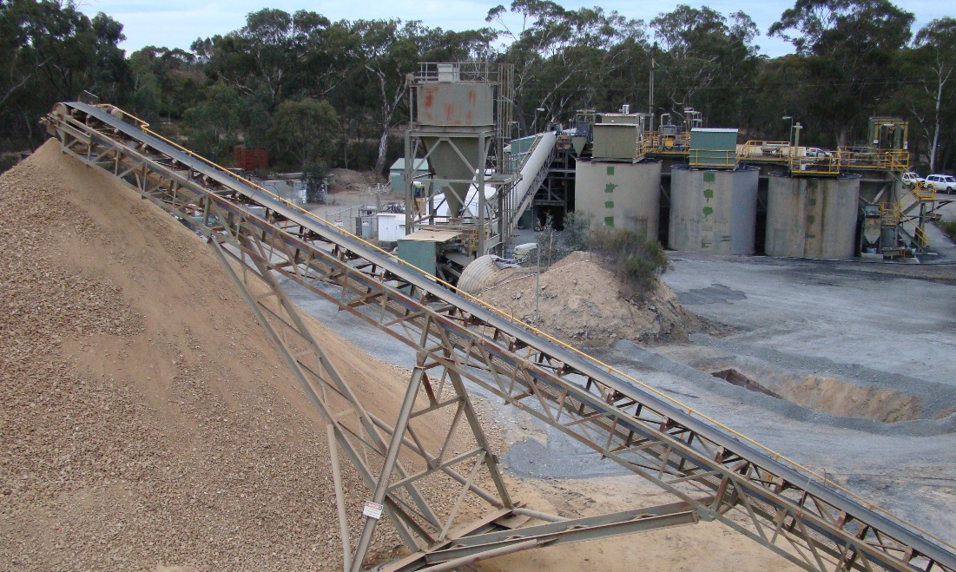
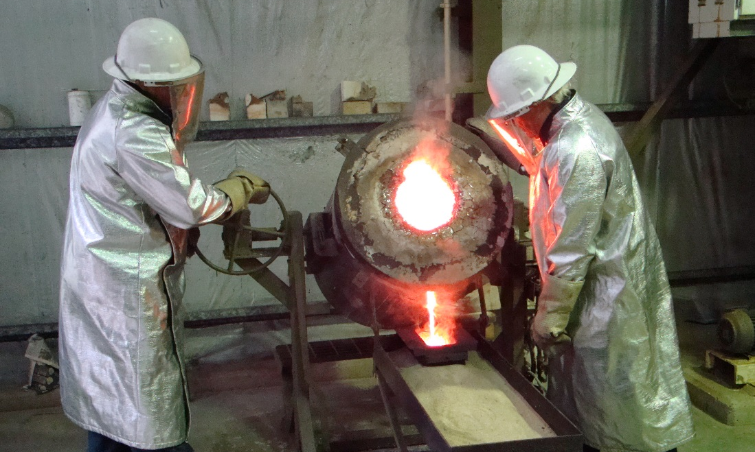
Octagonal Resources Limited

Slide 5
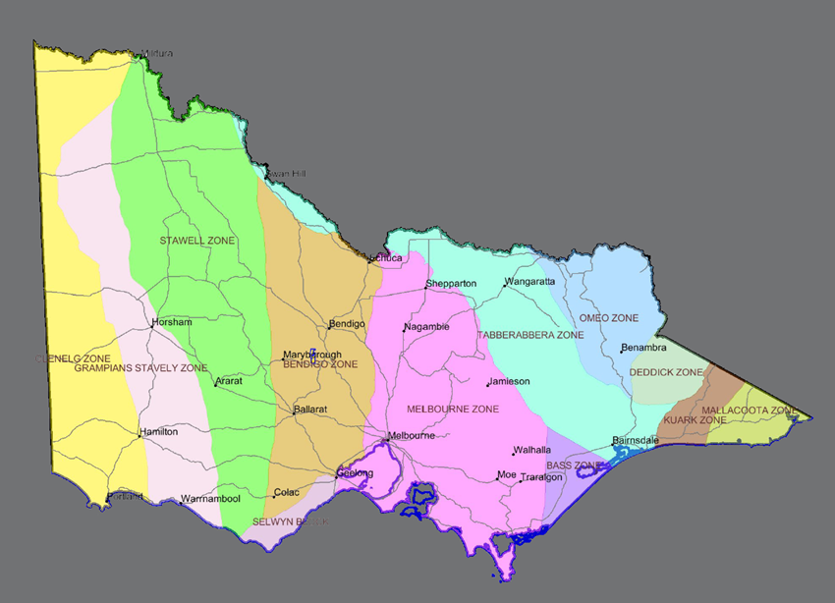
Regional Geology
Victorian Primary Gold
Total production: 80M oz
Primary production: 35M oz
Bendigo Zone
25M oz primary
Maldon
1.75M oz primary Au, av. 28 g/t Au
0.3M oz alluvial Au
MALDON

Slide 6
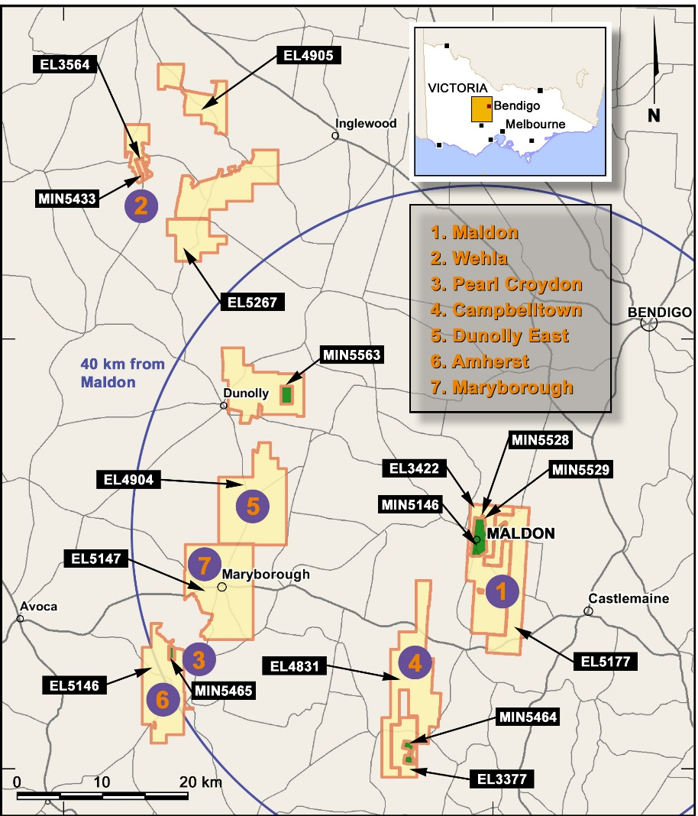
Octagonal Resources Limited
Maldon
150,000 tpa CIL gold mill
1.9 km long Union Hill Decline
Alliance South Deposit – 182,000oz
Wehla
Black Reef trial open pit mined
2 km long line of reef
Amherst
Pearl Croydon Deposit – 53,000oz
1.6 km long reef system
Dunolly
Specimen Reef Deposit – 10,500oz
1 km long line of reef
Campbelltown
Maryborough

Slide 7
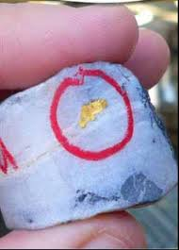
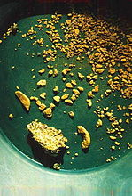
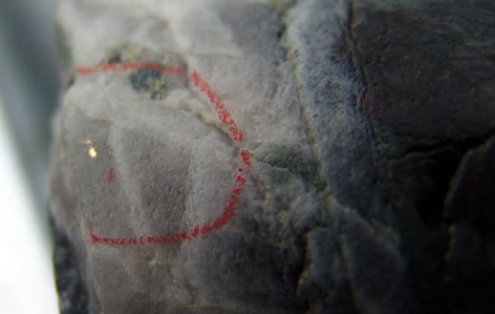
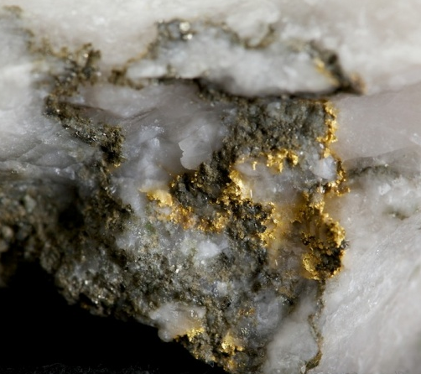
Nuggetty Gold
What is nuggetty gold ?
“Having the form of nugget; occurring in nuggets or lumps”
Gold that is randomly distributed, inhomogeneous, and difficult to predict
Does not always occur as coarse gold (eg: Eaglehawk Reef at Maldon)

Slide 8
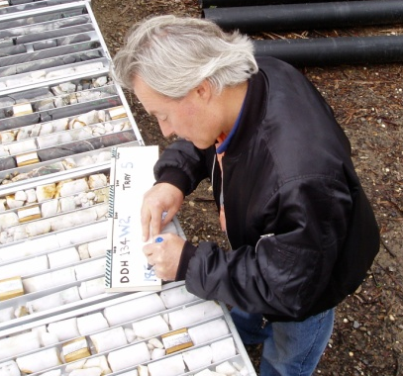
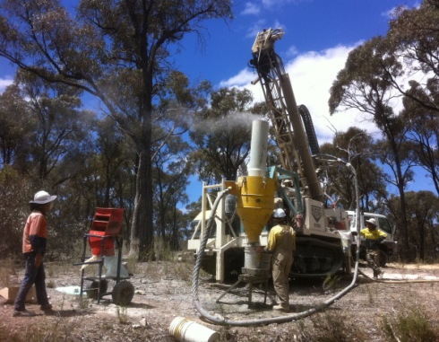
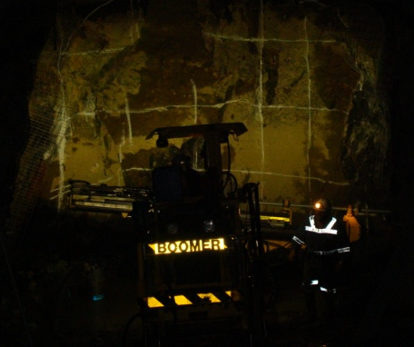
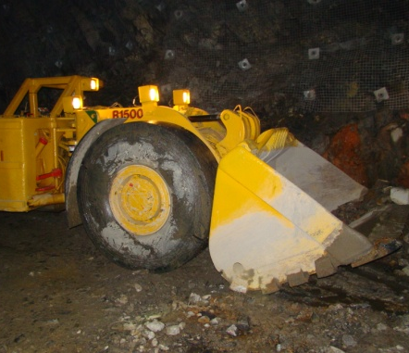
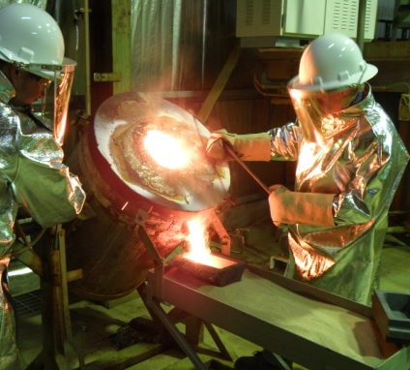
Commercial Challenges
Commercial challenges for mining nuggetty gold ?
What is my grade and how much gold have I got ?
When is enough drilling enough ?
How do I calculate Reserves if I can’t calculate Indicated Resources ?
If I don’t have Ore Reserves I can’t get bank funding !
How can I hedge if I can’t predict how much gold I am going to produce ?

Slide 9

Gold Business Model
1. Discover gold deposit - drilling
2. Increase resource base (+1 million ounce target) - drilling
3. Increase resource confidence - drilling
4. Financial modelling (+100,000oz pa production)
5. Convert resources to reserves
5. Financing ($100 - $200 million)
6. Develop operation - construction
7. Commence gold production
I am now a mid tier gold producer !

Slide 10
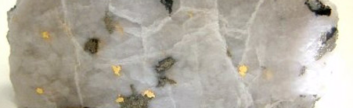
Gold Business Model
Nuggetty Gold Cannot Fit This Business Model !!!
Banks Don’t Like Me…
Institutions Don’t Like Me…
What Do I Do ???

Slide 11
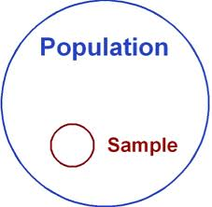
Gold Business Model
Sample Size is Key
Lots of drill holes
Big representative samples from drill holes
Bulk samples
Develop and mine ore body
I must understand my deposit
But…
When is enough drilling enough ???
Au
Au
Au
Au

Slide 12

Octagonal’s Solution
De-risk, de-risk, de-risk, de-risk, de-risk

Slide 13
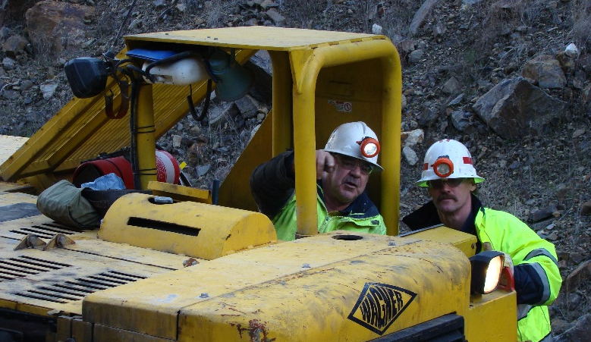
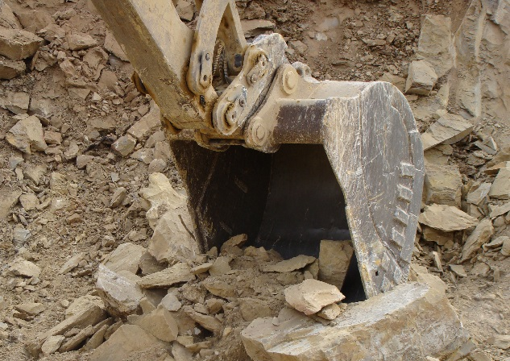
Victorian Mining Strategy
Develop a sustainable low risk, high grade, high margin gold operation
Focus on grade and profit not tonnes and ounces
Narrow vein mining – small mining equipment – owner operator
Understand the gold distribution and ground conditions of deposit
Low cash costs – small multi-skilled professional and experienced team
Develop multiple underground and open pit ore sources – strong project pipeline
Supplement production profile with third party ore
Use existing resources to fund Company growth

Slide 14
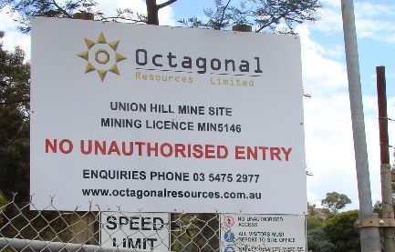
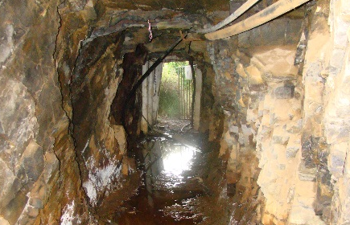
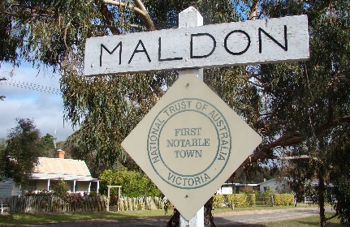
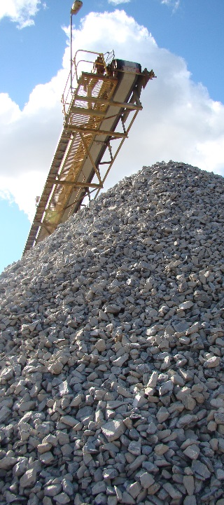
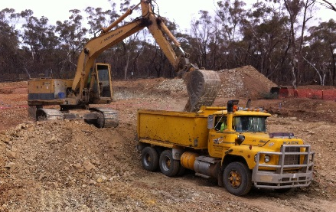
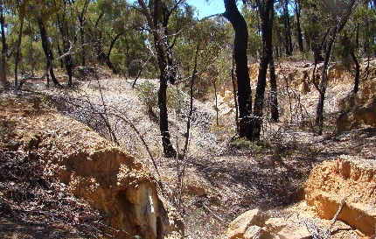
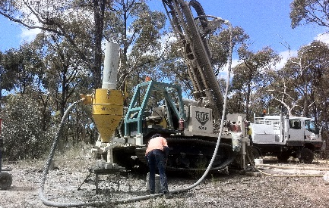
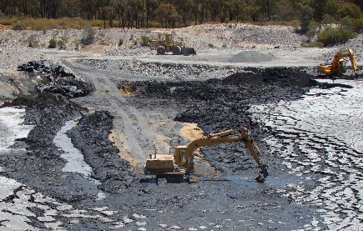
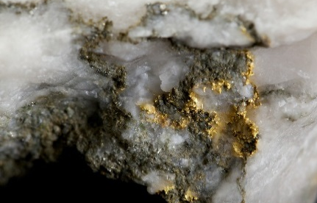
Ore Sources & Project Pipeline
2013
2014
2015+
$ $ $
Octagonal
Underground Ore
Alliance South
(Maldon)
Nuggetty Reef
(Maldon)
Central Maldon Shear Zone
(Maldon)
Octagonal
Open Pit Ore
Black Reef
(Wehla)
Pearl Croydon
(Amherst)
Specimen Reef
(Dunolly)
Ore Processing
Agreements
Maldon Gold
Processing Plant
(Maldon)
Kangaroo Flat tailings
(Bendigo)
A1 Gold Mine
(Woods Point)

Slide 15
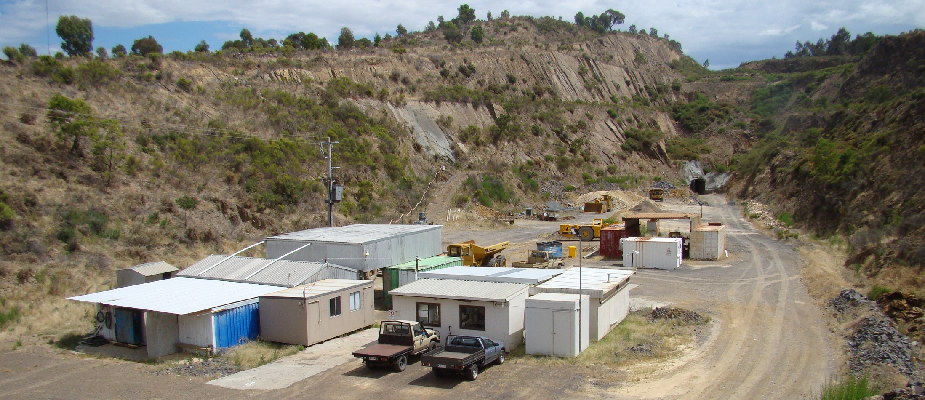
Alliance South Deposit
ALLIANCE SOUTH - MALDON
Inferred Resource: 473,000 tonnes grading 12.0 g/t Au for 182,000 ounces¹
Union Hill Mine Site
1: Refer to slide 45 – JORC Resource Inventory

Slide 16
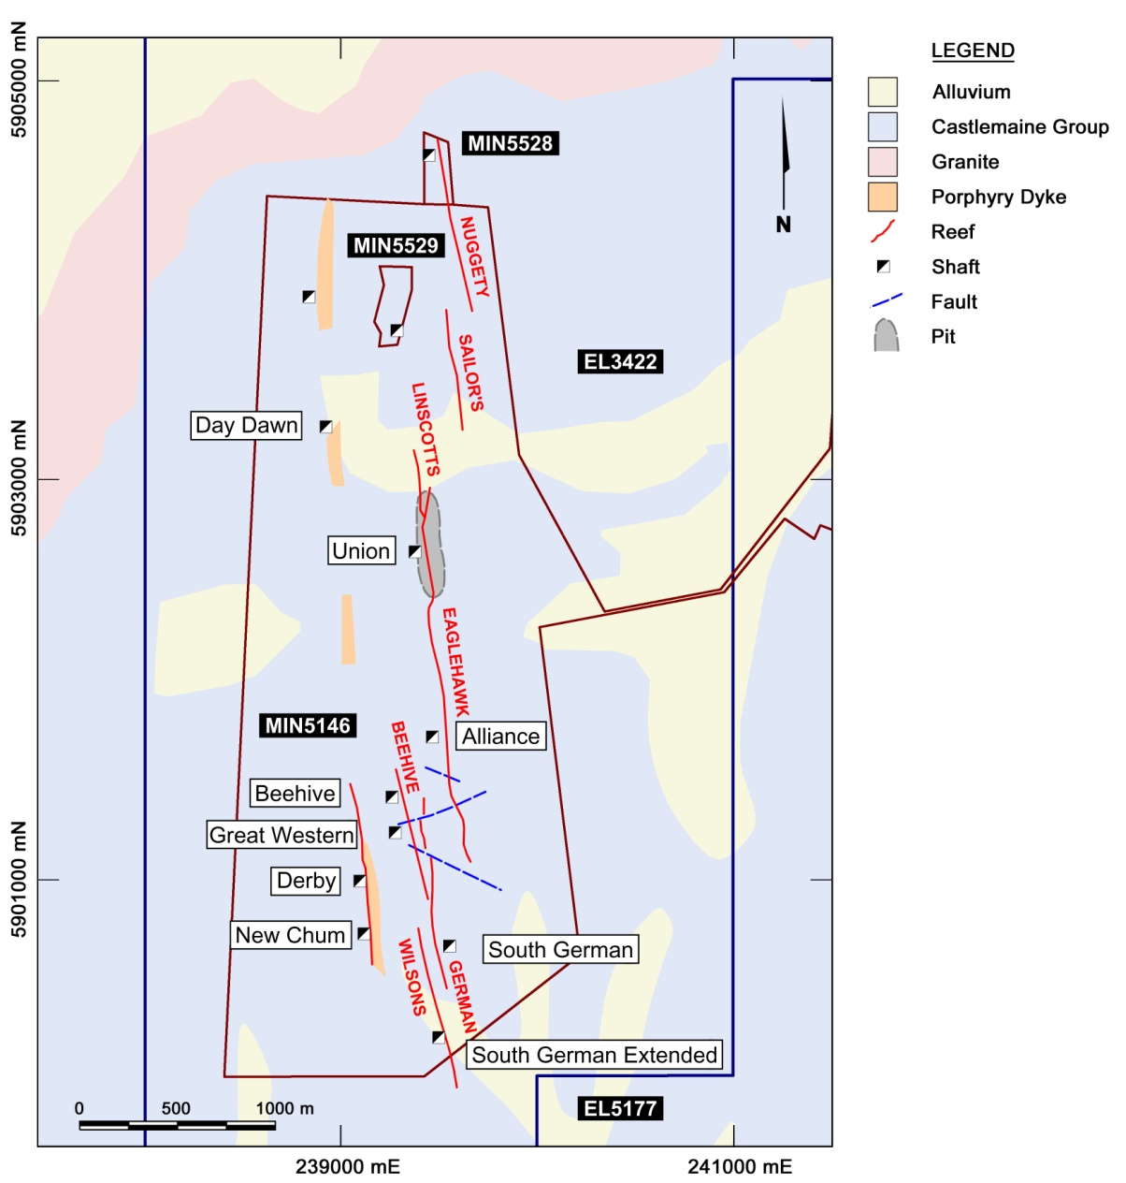
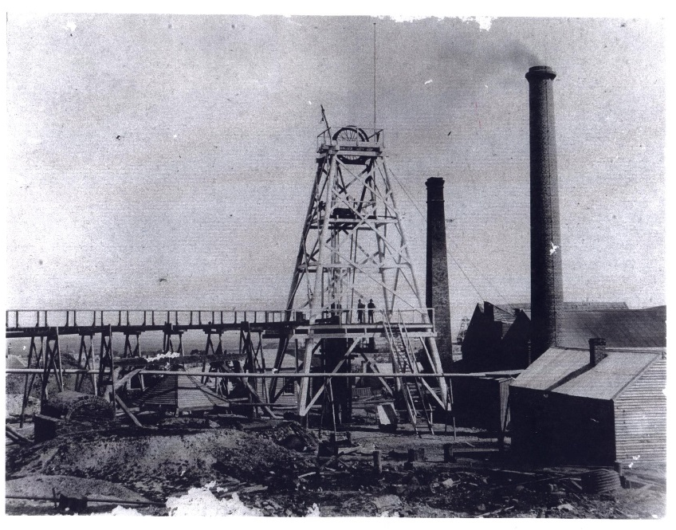
Central Maldon Shear Zone
Historic Production
1854 – 1920
1.47 million ounces
Nuggetty Reef: 301,000 oz
Eaglehawk Reef: 491,000 oz
Beehive Reef: 250,000 oz
German Reef: 277,000 oz
Victoria & Derby Reef: 150,000 oz
Alliance
South
Deposit
400m
Photo: Alliance Shaft (Eaglehawk Reef)

Slide 17
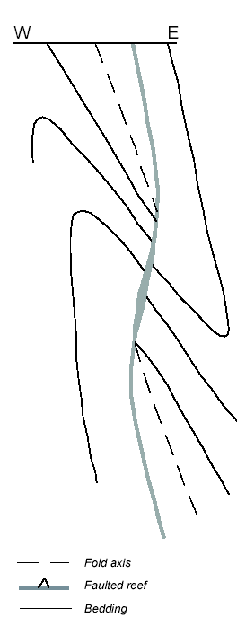
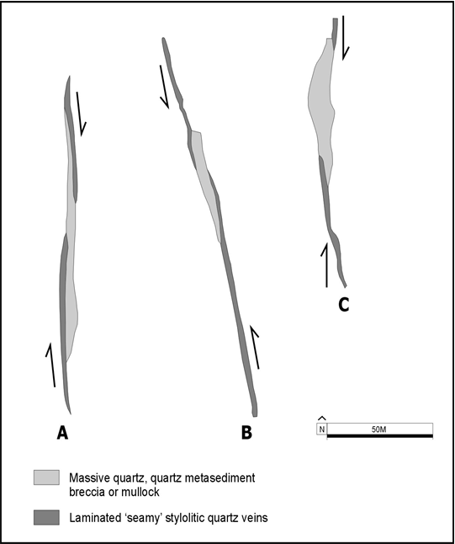
Structural Controls
Cross - Section
Plan

Slide 18
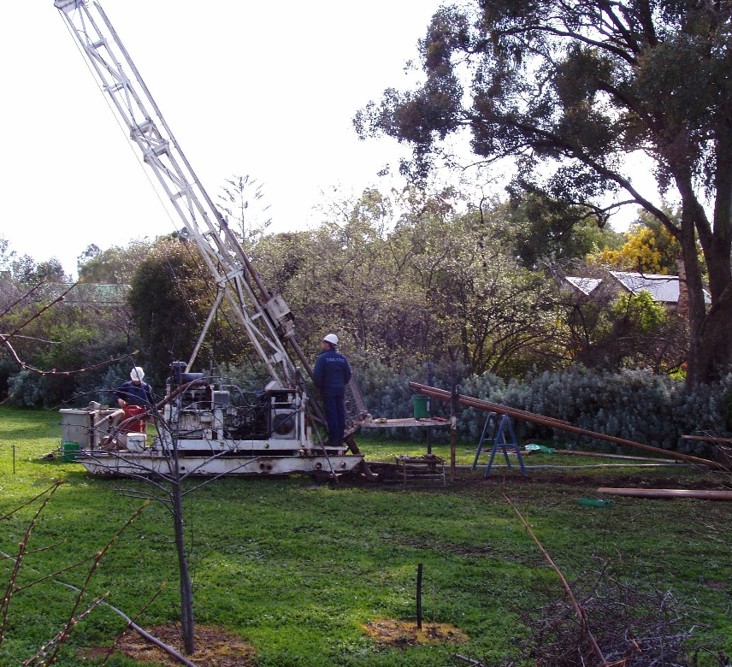
Discovery History
2003
3D modelling of historic mine workings commenced
2004
Conceptual structural targeting - 10 priority targets
Diamond drilling commenced
Immediate discovery of Alliance South - first hole
DDH89 - three visible gold intercepts
2005
32 diamond holes drilled for 8,487 metres
Initial internal resource estimate
Decision for bulk sample and mine design
2006
Exploration decline commenced
2008
Moon’s Cross Course intersected - decline placed on care and maintenance
2011
Octagonal Resources re-commences development of decline

Slide 19
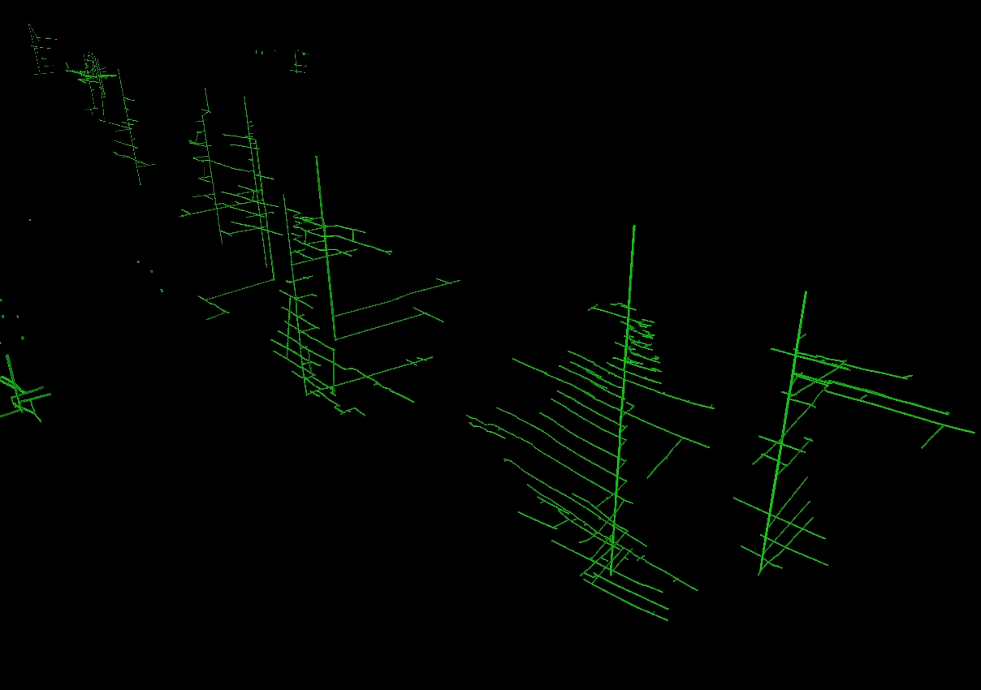
3D Model
N
Historic mine workings

Slide 20
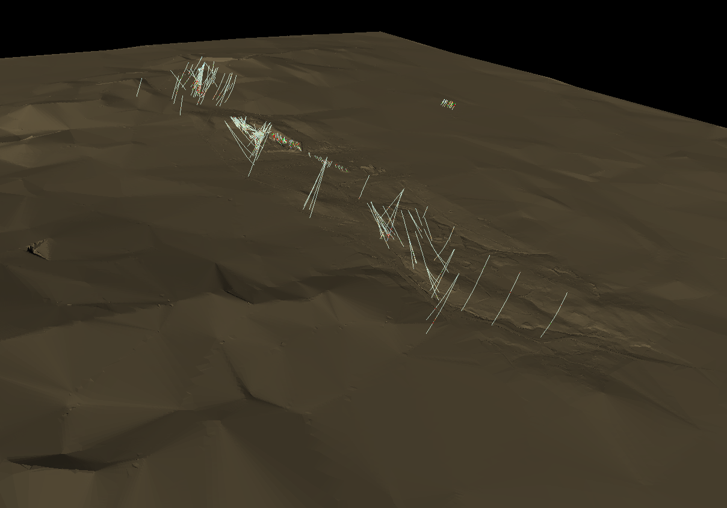
3D Model
N
Alliance South
Target Area
Drilling data & topography

Slide 21
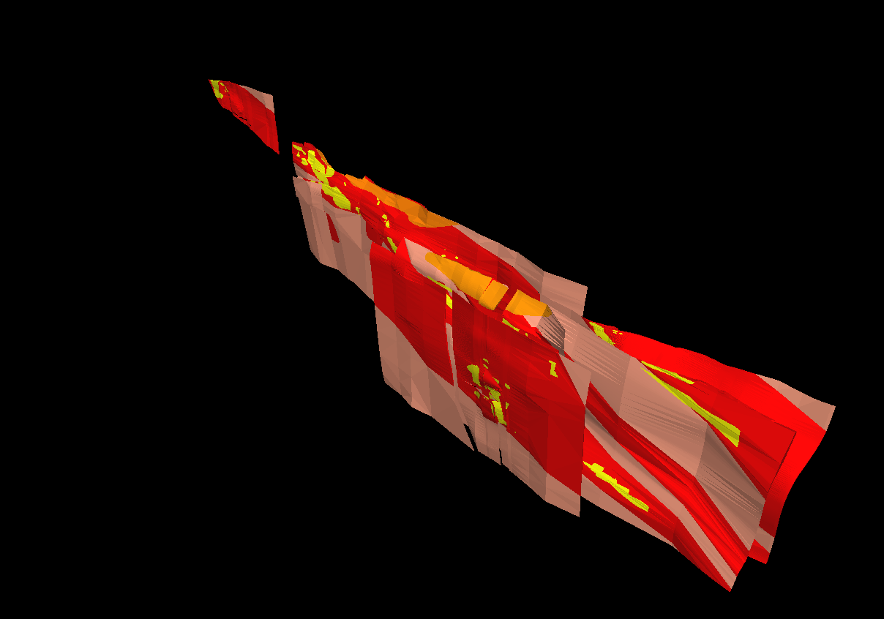
3D Model
N
4 kilometres
supergene gold
ore shoot
quartz reef
structure only
Reefs & historic mined ore shoots

Slide 22
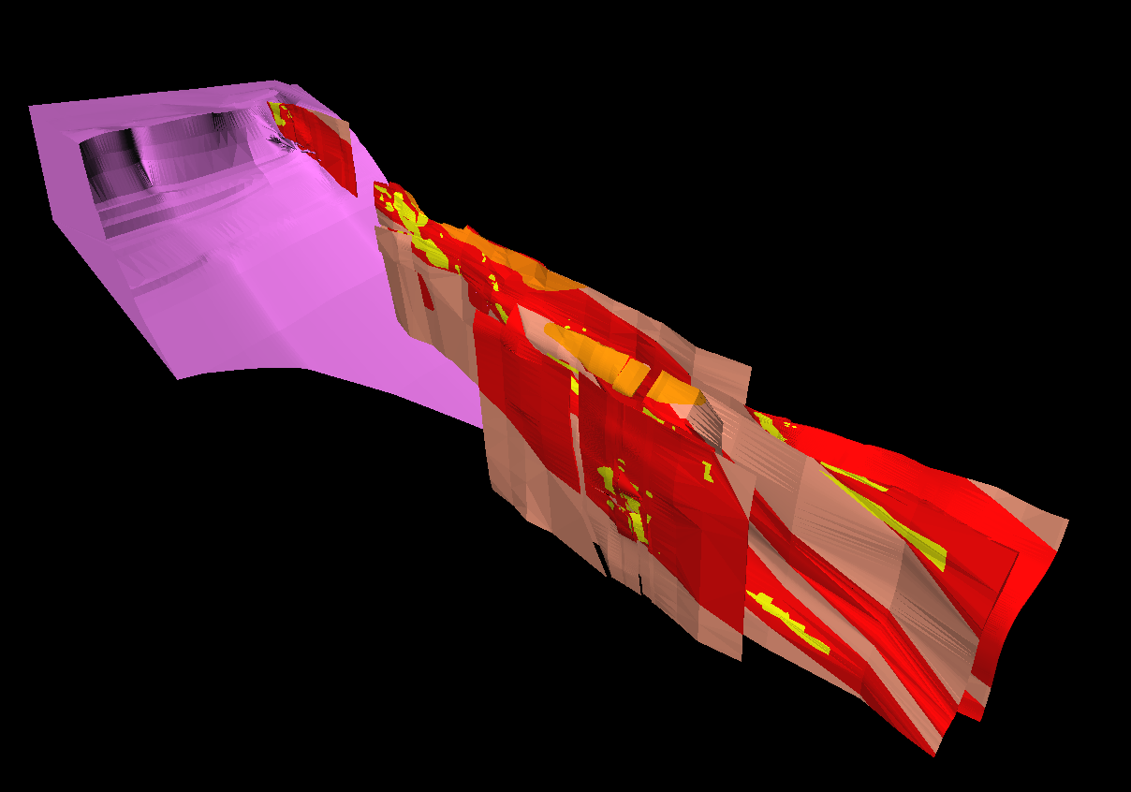
3D Model
N
4 kilometres
supergene gold
ore shoot
quartz reef
structure only
granite
Harcourt Granodiorite

Slide 23
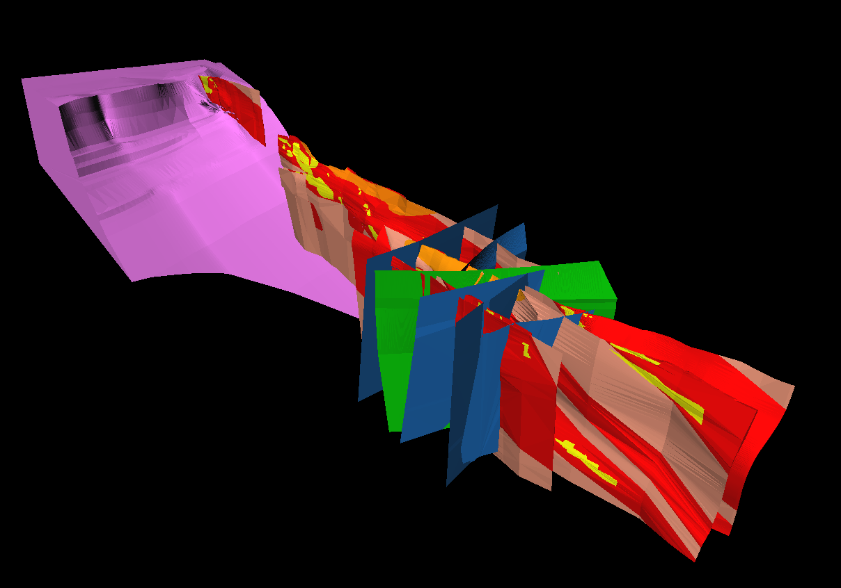
3D Model
N
4 kilometres
supergene gold
ore shoot
quartz reef
structure only
granite
east-west cross-course fault
northwest cross-course fault
Late east-west cross-course faults

Slide 24
3D Model
N
Cross-section
4 kilometres
supergene gold
ore shoot
quartz reef
structure only
granite
east-west cross-course fault
northwest cross-course fault
Late east-west cross-course faults

Slide 25
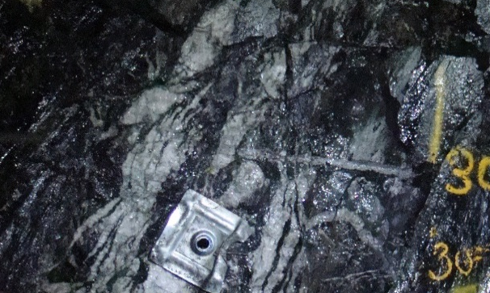
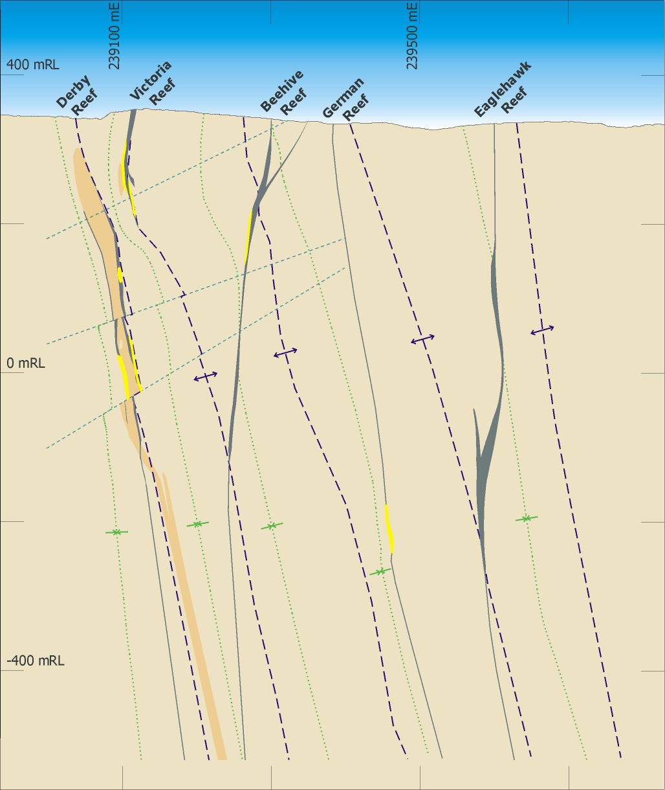
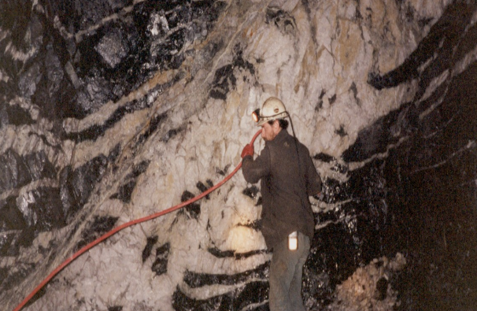
Cross-Section
anticlines
Structural position of
Alliance South Shoot
Structural position of
Union Shoot &
Alliance Shoot
synclines

Slide 26
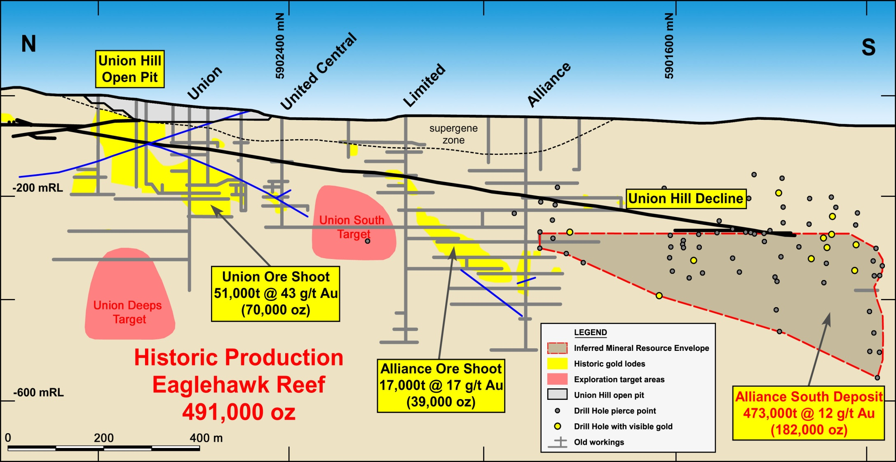
Alliance South Deposit
Alliance South Shoot
Eaglehawk Reef: Long Section

Slide 27
Alliance South Drilling
Sampling
HQ diamond core where possible with NQ2 wedges
Deposit defined with 40 metre by 50 metres spaced drilling
Some infill to 20 metre by 25 metre spaced drilling
Sampling to lithological boundaries
Half core samples (maximum sample length 1.3 metres)
Routinely sampled south side of core
BUT….. if visible gold intersected – retained half of core with visible gold
Analysis
Total samples pulverised before splitting
400 gram to 1 kilogram BLEG with fire assay of residue if Au > 0.4 g/t Au
Reef and altered zones also analysed for As, Ag, Cu, Pb, Zn, Bi, Te, Mo, Ni & Sb

Slide 28
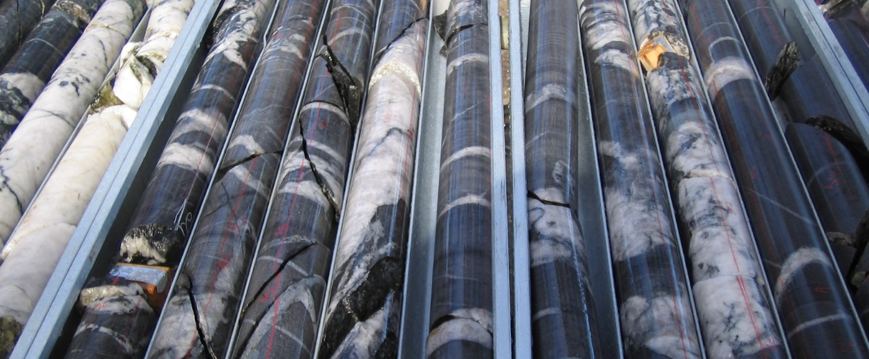
Alliance South Drilling
Effect of retaining core with visible gold
Example of Holes with Visible Gold
Hole_ID | Interval (m) | Grade (g/t Au)
DDH089 | 0.25 | 2.72
DDH089 | 0.70 | 2.61
DDH089 | 0.25 | 5.06
DDH091 | 0.85 | 1.91
DDH092 | 1.05 | 0.74
DDH100 | 0.90 | 0.37
DDH100 | 0.90 | 1.22
DDH104 | 0.75 | 44.39
DDH104 | 0.75 | 2.76
DDH107 | 0.90 | 7.30
DDH108 | 0.85 | 3.48
DDH110 | 0.90 | 2.27
DDH110 | 1.00 | 0.13
DDH110 | 0.80 | 35.28
First 18 holes → 14 visible gold intersections

Slide 29
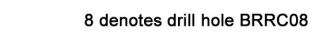
Alliance South Drilling
Sample Population (Eaglehawk Reef Intersections)
9% of drill holes into reef with
ore-grade intersections (>10 g-m Au)
Peak result: <60 g-m Au
22% >5 g/t Au
52% >1 g/t Au
n = 96

Slide 30
Alliance South Drilling
Repeat Analysis of Diamond Half Core
Repeat Analysis
Total samples pulverised
before splitting
2 kilogram BLEG with
fire assay of residue if
Au > 1.0 g/t Au
6 samples
>10 g/t Au
poor correlation
3 samples
>10 g/t Au
n = 82

Slide 31
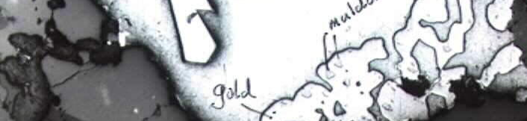
Use of Path Finders
Correlation of Gold with Path Finder Elements
Multi-element analysis of 2,825 samples for Au, As, Ag, Cu, Pb, Zn, Bi, Te, Mo, Ni & Sb
No correlation between elements until sorted by As
For populations with >200ppm As good correlation
Correlation further improves with higher As cut-off values
Genetic connection between Au, Bi, Te, As, Sb, possibly Cu & Ag
Two Phases of Gold Mineralisation
445 – 420 Ma: Orogenic (main mineralising event)
375 – 360 Ma: Retrograde (associated with intrusion of granites)
maldonite
asp
bismuth
gold

Slide 32
Sample Analysis & Interpretation
New Underground Drill Sample Procedure
Core photographed and whole core sampled
Analysis by 2kg BLEG → ensures “all of the drill core sees the acid”
Fire assay of residue if sample returns >5g/t Au
Samples from ore zone routinely analysed for Au, As, Bi, Ag
Interpretation of Drilling Results
Drill using 40 metre by 50 metre spaced grid → this defined the Alliance South Ore Shoot
Drill intersections considered potentially indicative of an ore shoot:
    Visible gold
    High gold assay results
    High arsenic with bismuth and silver
    Seamy or laminated grey quartz
    Favourable structural position

Slide 33
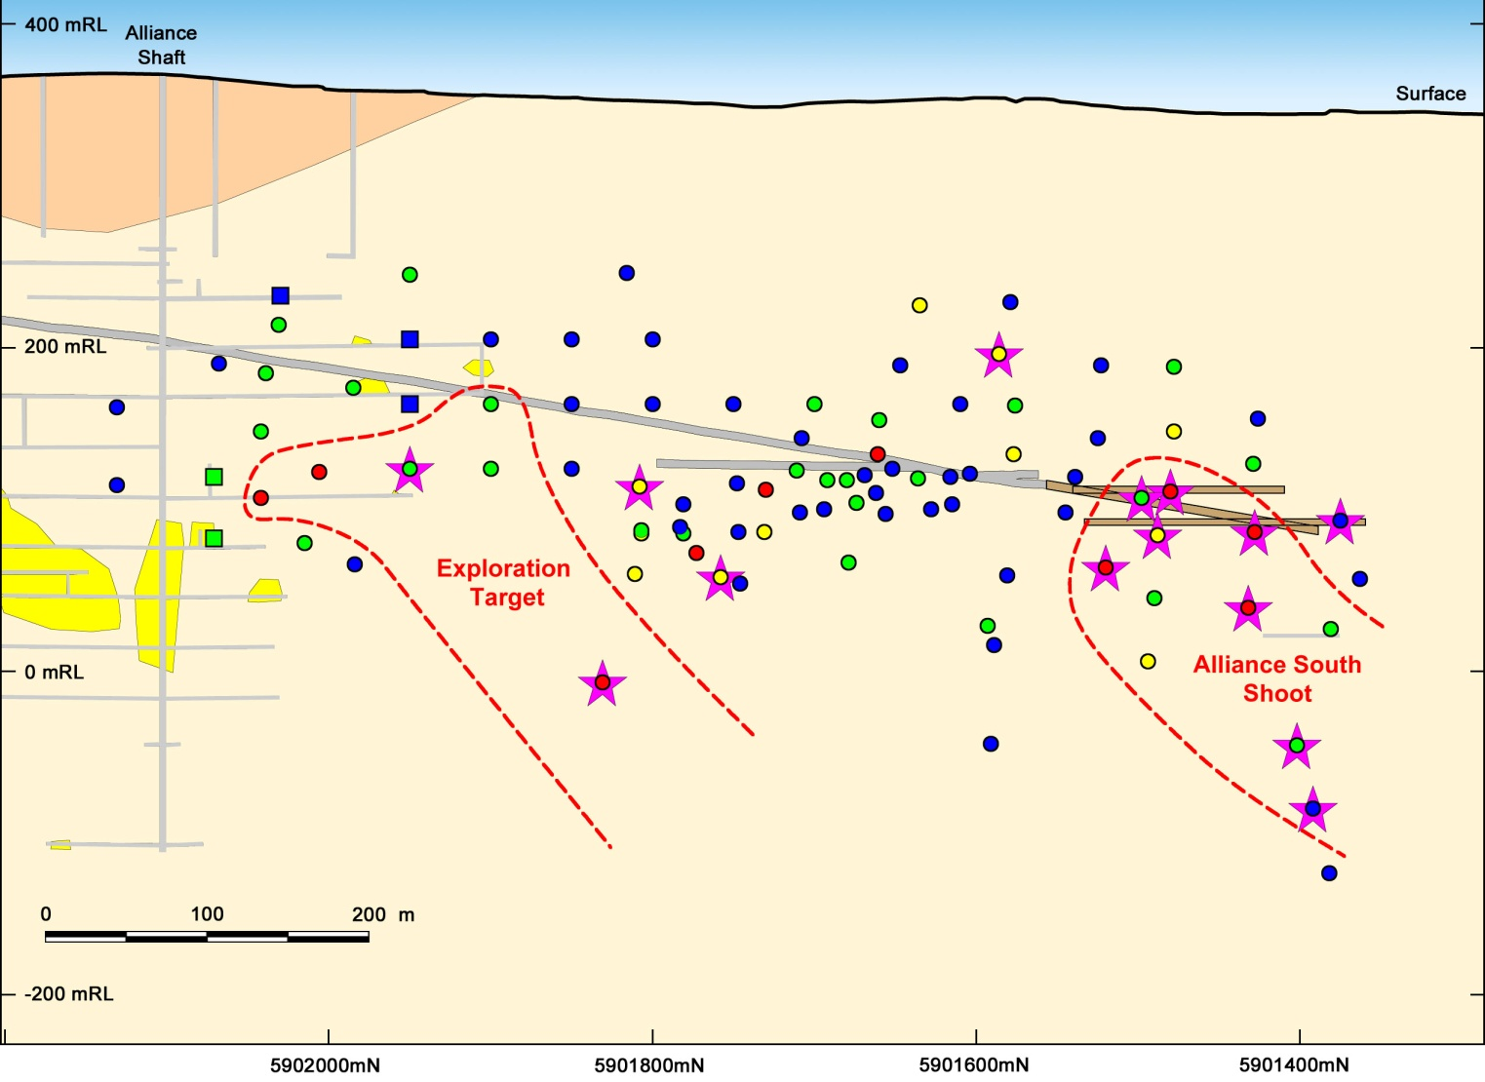
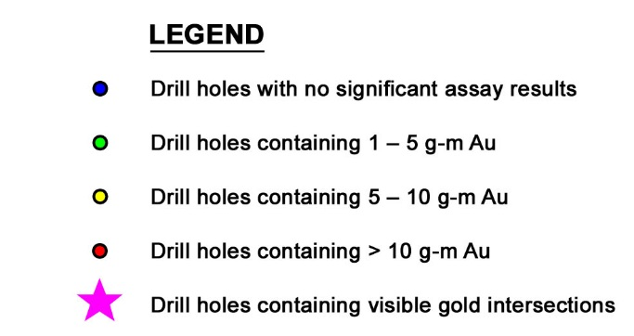
2011 Diamond Drilling
16 holes
Alliance South: Long Section

Slide 34
2011 Diamond Drilling
$350,000 spent
No results +5 g-m
workings
Au
Vis. Au, As,
seamy qtz
As,
seamy qtz
Au, Vis. Au
Alliance South: Long Section

Slide 35
2011 Diamond Drilling
$350,000 spend =
100m drive development
Alliance South: Long Section

Slide 36
Alliance South Mine Plan
mine development
1100L
1080L
Alliance South: Long Section

Slide 37
Alliance South Mine Plan
mine development
1100L
1080L
Cross-section
Alliance South: Long Section

Slide 38

Alliance South Mining
Bulk Sample – Not Cheap !!!
2,000 metres decline development
4.0 x 4.5 metre size
Cost: $20 million
60 metres cross cut development
3.5 x 3.5 metre size
Cost: $250,000
Mining fleet
Twin boom jumbo (second unit for spares)
Single boom jumbo
Two 30 tonne dump trucks
Bogger
Grader
Loader
Cost: $950,000
Reef development
Cost: $3,500/m - $4,000/m
NSA
1100 level
cross-cut
35 metres
3m @ 12.0 g/t Au
25 metres
5901515mN Cross-Section

Slide 39

1100 Level Plan
N
N
visible gold in hole
2.55m @ 7.0 g/t Au
120 metres
1.2m @ 1.6 g/t Au
50 metres
visible gold in hole
0.85m @ 3.5 g/t Au
visible gold in hole
1.05m @ 24.0 g/t Au
western splay
NSA
5 metres
Interpreted from drilling
Mapped during mining

Slide 40

Sample Size
3.5m true width HQ = 50 kilograms
7m down hole @ 60° = 3.5m true width
Visible gold in hole 0.85m @ 3.5 g/t Au

Slide 41

Sample Size
3.5m x 3.5m x 1m face = 30 tonnes

Slide 42

Latest Face

Slide 43

Conclusions
  Nuggetty gold deposits present both
  commercial and technical challenges
  that are unique in the mining industry
  Tackling the commercial challenges requires
  a detailed understanding of the deposit
  style and risks
  Representative sampling is crucial
  Sample size is key to understanding a
  nuggetty gold deposit - not only volume of
  sample, but also volume of geological and
  structural observations
  Evaluate cost benefit and risk of
  drilling vs bulk sampling vs mining
  Consider if other data can support assay results
  (geological, structural, analytical)
  Smart geology needed for smart mining

Slide 44

ASX Code: ORS
Thank you
Photo: Diamond Drilling at Maldon

Slide 45
Presentation Appendix
JORC RESOURCE INVENTORY
Alliance South Mineral Resource Estimate (October 2009)
Deposit | Location | Estimated Gold Resource and Category
 |  | Measured |  |  | Indicated |  |  | Inferred
 |  | ‘000t | Au g/t | ‘000oz | ‘000t | Au g/t | ‘000oz | ‘000t | Au g/t | ‘000oz
Alliance South | West Zone |  |  |  |  |  |  | 287 | 12 | 110
 | East Zone |  |  |  |  |  |  | 186 | 12 | 72
Total |  |  |  |  |  |  |  | 473 | 12 | 182
Pearl Croydon Mineral Resource Estimate (July 2010)
Deposit | Reef | Resource | Tonnes | Gold Grade | Gold
 |  | Category |  | (g/t) | (ounces)
Pearl Croydon North | West Reef | Inferred | 142,444 | 2.3 | 10,702
 | Central Reef | Inferred | 293,010 | 2.4 | 22,812
 | East Reef | Inferred | 20,072 | 4.6 | 2,949
 | Sub Total | Inferred | 455,526 | 2.5 | 36,463
London Hill | Main Reef | Inferred | 49,612 | 4.4 | 6,957
 | Hanging wall Reef | Inferred | 27,515 | 4.1 | 3,665
 | Sub Total | Inferred | 77,128 | 4.3 | 10,622
Mullocky | West Reef | Inferred | 13,693 | 2.7 | 1,188
 | East Reef | Inferred | 24,212 | 6.5 | 5,091
 | Sub Total | Inferred | 37,905 | 5.2 | 6,278
 | TOTAL | Inferred | 570,559 | 2.9 | 53,364
Specimen Reef Mineral Resource Estimate (March 2012)
Deposit | Estimated Gold Resource and Category
 | Indicated |  |  | Inferred
 | Tonnes | Au g/t | ‘000oz | Tonnes | Au g/t | Ounces
Specimen Reef |  |  |  | 114,000 | 2.9 | 10,480
Total |  |  |  | 114,000 | 2.9 | 10,480

